Slide 1
Chapter 5: Electrochemical cells
Electrode potentials

Slide 2
Using a standard to rank oxidising strength
The oxidising strength of an element is used to predict reactions based on the element activity.
To determine the oxidising strength, all chemical species are compared to a reference cell containing hydrogen gas (H₂) and hydrogen ions (H⁺). The electrode used is a piece of platinum.
This arrangement is known as a half-cell. It is called a standard hydrogen cell.

Slide 3
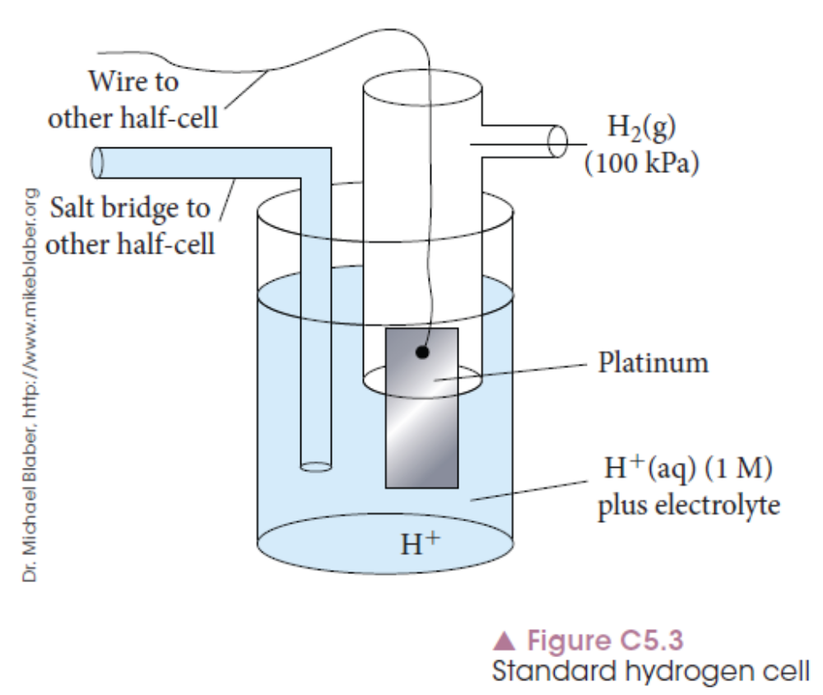
Using a standard to rank oxidising strength
The hydrogen gas is bubbled into the hydrogen ion solution. Platinum metal is used to conduct the electricity through the half cell.

Slide 4
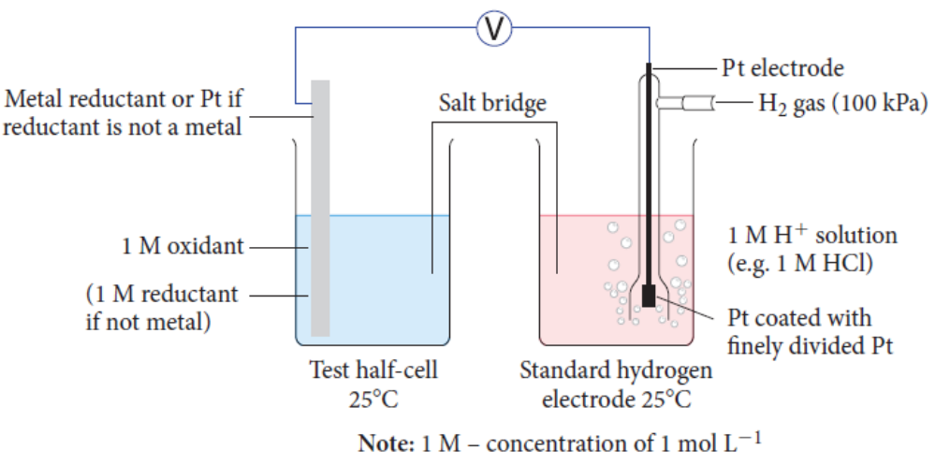
Using a standard to rank oxidising strength
A metal is tested against the standard hydrogen electrode by setting up a circuit with the two half cells.

Slide 5
Using a standard to rank oxidising strength
The test half cell contains the metal to be tested, dipped into a solution of the same metal ion.
The two half cells are connected via an external wire and a salt bridge to complete the circuit and allow electricity to flow.
The voltage difference generated is measured and determines the oxidising strength of the test half cell species.

Slide 6
Half-cell conditions
When setting up half-cells, the following conditions are used to ensure valid data is collected regardless of the chemical species being tested.
Solutions are 1.0 mol L^{–1}
Solutions are at 25°C
Gases are at 25°C and 100 kPa

Slide 7
Determining standard half-cell potentials
Values are measured relative to the hydrogen half-cell that is given a value of 0.00 V.
The voltage reading that indicates the difference in voltage between the two half cells is thus the voltage (E°) assigned to the test half cell.
If a species is more likely to gain electrons than hydrogen its E° value is positive. If it is more likely to lose electrons, its E° value is negative.

Slide 8
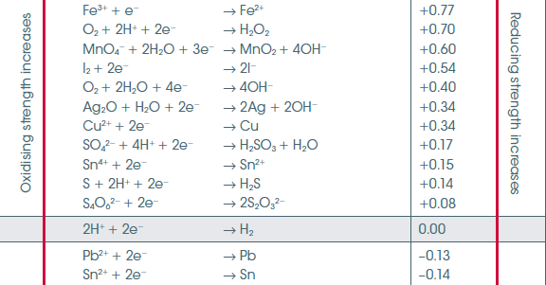
Table of standard electrode potentials
A section of the table is seen below.
Notes:
See full table C5.1 in Chapter 5.

Slide 9
Table of standard electrode potentials
All half reactions in the table are written in reduction form as they all gain electrons (OIL RIG).
Species more likely to be oxidised are at the bottom of the table and have negative E° values.
Species more likely to be reduced are at the top of the table and have positive E° values.
As you move down the table, the species become stronger reducing agents.

Slide 10
Chapter 5: Electrochemical cells
Galvanic cells

Slide 11
Basic principle and construction
A galvanic cell uses two half-reactions in separate containers and makes use of the spontaneous nature of the reactions to generate an electric current.
The transfer of electrons in the redox reaction is harnessed through physical separation of the two half-reactions.

Slide 12
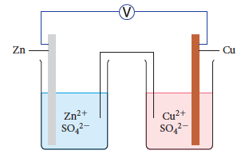
Basic principle and construction
The galvanic cell between zinc and copper is set up by having a zinc metal/ions half cell and a copper metal/ions half-cell.
The two half-cells are connected by an external wire with a voltmeter attached to measure the voltage generated.

Slide 13
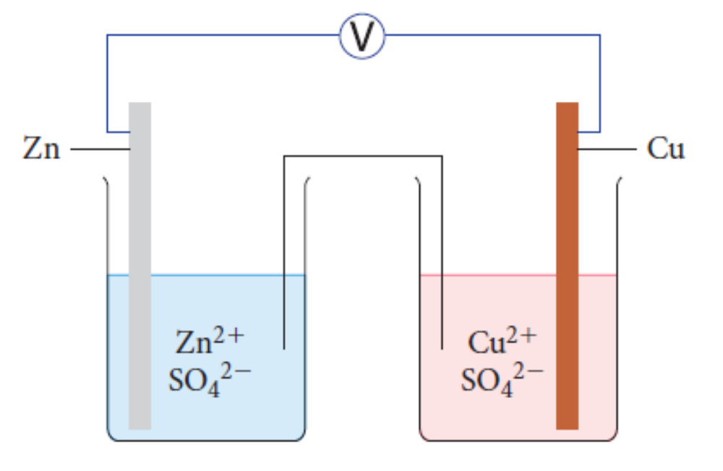
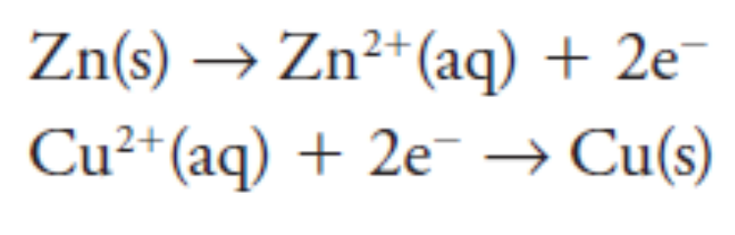
A zinc/copper galvanic cell
The zinc is more reactive, so oxidises and loses electrons that flow through the wire to the copper, generating current.
The zinc is the anode (oxidation) and the copper is the cathode (reduction).

Slide 14
A zinc/copper galvanic cell
A salt bridge joins the two half cells.
It is soaked in a soluble salt solution like potassium or sodium nitrate.
Movement of ions in the salt bridge allow flow of charge through the cell and complete the circuit.
Anions flow to Anode, Cations to Cathode eg Zn²+ to + cathode and SO₄²⁻ to - anode.

Slide 15
A zinc/copper galvanic cell
As the zinc metal oxidises, the mass of the zinc metal, called an electrode, will decrease over time. This electrode is negative.
The reduction of copper ions forms solid copper on the copper electrode, increasing its mass. This electrode is positive.
Anode = negative Cathode = positive

Slide 16

Using standard electrode potentials
For the same galvanic cell, the half equations are identified from the table of standard electrode potentials.
As the zinc is oxidising, and all electrode potential equations are written as reduction equations, the reaction must be reversed. The E° value is also reversed.

Slide 17


Using standard electrode potentials
The overall reaction for the cell can be written by adding the two half-equations, first checking that the electrons are balanced. Balance half-equations as necessary so electrons are balanced.
The E° values are also added to give the overall cell voltage.
Hence:

Slide 18
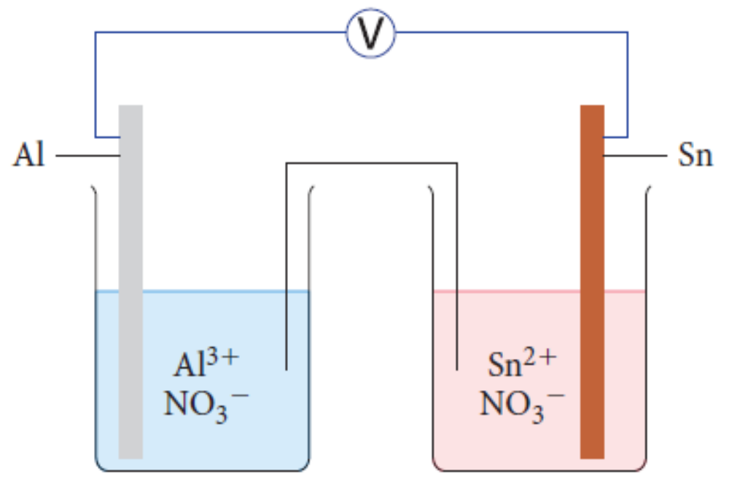

Using standard electrode potentials
This method can be used even when the more active species in a galvanic cell is not known.
From the table of standard electrode potentials, identify the half-reactions and their potentials.

Slide 19

Using standard electrode potentials
Method 1: The table is in order of activity. Aluminium is higher than tin, so is more likely to oxidise.
Its reaction needs to be reversed before addition.

Slide 20
Using standard electrode potentials
Method 2: All galvanic cells have an overall positive voltage because the reactions are spontaneous, and only a positive voltage indicates a spontaneous reaction.
If adding the two standard electrode potentials, the overall voltage is positive only if aluminium is reversed.
Notes:
Use Worked example 5.1 to show examples of gas and solution half cells. No change to method, just use of an inert electrode instead of an active metal electrode.

Slide 21
Chapter 5: Electrochemical cells
Fuel cells

Slide 22
Introduction
A fuel cell converts chemical energy into electrical energy without the need for combustion reactions.
Fuel cells are available for cars and power generation, providing an alternative to fossil fuel powered systems.
A fuel cell is a type of galvanic cell with some structural differences.

Slide 23
Hydrogen fuel cell – structure/construction
A commonly used fuel cell is a hydrogen fuel cell that uses hydrogen as a fuel to generate electricity.
A hydrogen fuel cell only requires hydrogen and air to function, and only produces water as a waste product.

Slide 24
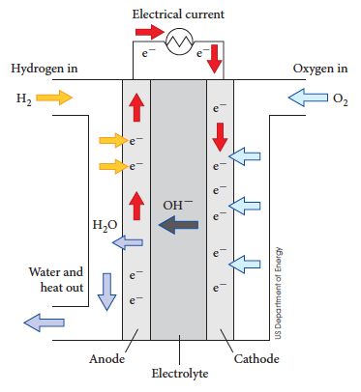
Hydrogen fuel cell – structure/construction

Slide 25

Hydrogen fuel cell – structure/construction
The hydrogen is fed into the anode, where it oxidises.
Oxygen from the air reduces at the cathode.
Hydroxide ions produced at the cathode pass through the central part of the cell and are used at the anode. The end product of the whole reaction is water. Note this is in alkaline conditions.

Slide 26
Hydrogen fuel cell – structure/construction
The fuel cell has an anode and cathode compartment – a space in which the oxidation (anode) and reduction (cathode) reaction occurs.
In between the two compartments is an electrolyte that allows ions to pass through. In this case the hydroxide ions flow from cathode to anode.
Electrons cannot pass through the electrolyte, but pass through the external wire and are used to power a device.

Slide 27
Hydrogen fuel cell – structure/construction
Electrodes in a fuel cell are porous (contain holes) to allow gases to flow through.
The electrodes also contain catalysts such as platinum, rhodium and nickel. The catalyst helps the reaction occur by helping to break down the gaseous molecules so they can react.

Slide 28
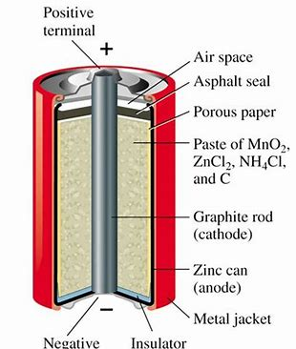
Leclanche or Dry Cell
The Leclanché cell is a battery invented and patented by the French scientist Georges Leclanché in 1866. The battery contained a conducting solution of ammonium chloride, a cathode of carbon, a depolarizer of manganese dioxide, and an anode of zinc. The chemistry of this cell was later successfully adapted to manufacture a dry cell.

Slide 29
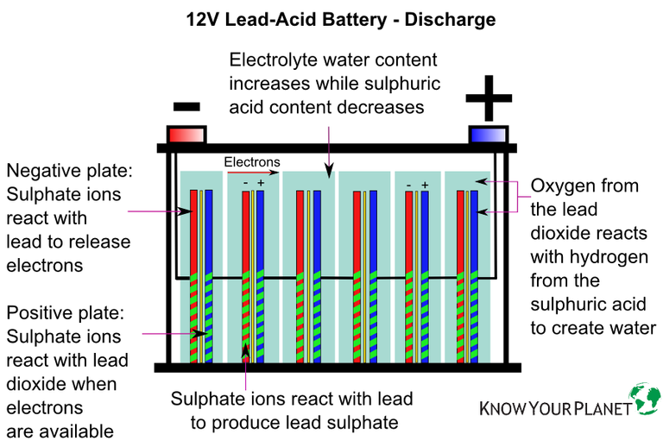
Lead Acid battery

Slide 30
Redox equations for lead battery
The following half equations can be derived at discharge.
Anode/oxidation: Pb_{(s)} + SO₄²⁻_{(aq)} → PbSO_{4(s)} + 2e⁻ Eº = 0.36 V
Cathode/reduction: 4H⁺ + PbO_{2(s)} + SO₄²⁻_{(aq)}+ 2e⁻ → PbSO_{4(s)} + 2H₂O_{(l)} Eº =1.69V
Lead at the anode goes from 0 to +2
Lead oxide at the cathode goes from +4 to +2
Adding both equations :
Pb_{(s)} + PbO_{2(s)} + 4H⁺_{(aq)} + 2SO₄ ²⁻_{(aq)} → 2 PbSO_{4(s)} + 2H₂O_{(l)} Eº = 2.05 volts
A typical automobile battery consists of 6 cells in series and generates a total of 12V
The electrolyte is 5-6 M H₂SO₄

Slide 31
Metal nanomaterials
The platinum catalyst in a fuel cell contributes to the cost of the fuel cell.
Nanoparticles are being used in some fuel cells to decrease the cost of the cell and make it more viable for widespread use.

Slide 32
What is a nanoparticle?
A nanoparticle is around one-billionth of a metre in size.
A volume of nanoparticles compared to a solid metal of the same size will have a much larger surface area.
To get the same reaction rate, less nanomaterial is required, lowering the cost of the fuel cell.

Slide 33
Chapter 5: Electrochemical cells
Electrolytic cells – molten salts

Slide 34
What is an electrolytic cell?
An electrolytic cell converts electrical energy into chemical energy.
Electricity is used to force a non-spontaneous reaction to occur.
Rechargable batteries are an example of an electrolytic cell.

Slide 35
Electrolytic cell structure
An electrolytic cell uses one electrolyte with positive and negative ions.
Two electrodes, an anode and cathode are dipped into this electrolyte. Electrodes made of inert substances such as carbon or platinum.
Oxidation still occurs at the anode, but the anode is positive in an electrolytic cell.
Reduction occurs at the cathode, but the cathode is negative.

Slide 36
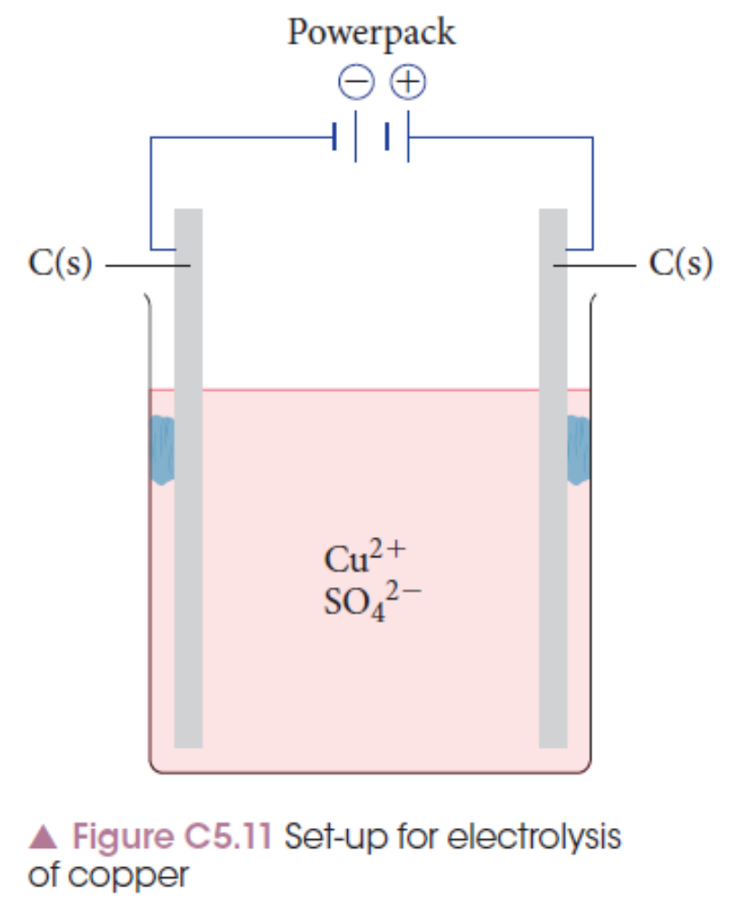
Electrolytic cell structure

Slide 37
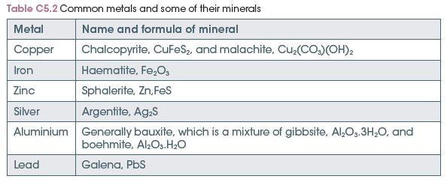
Uses – metal extraction
Metals are usually found in combined form with elements such as oxygen, sulfur and hydrogen. These are called minerals.

Slide 38
Uses – metal extraction
Because most metals are highly reactive, the reduction of the metal ion in the mineral to the solid metal is not a spontaneous reaction.
Electrolysis is used to force the metal ion to reduce and produce the active metal.
Notes:
Experiment 5.2 – Extraction of copper by Electrolysis – explain the process of metal extraction through production of copper metal from a solid sample of copper carbonate.

Slide 39
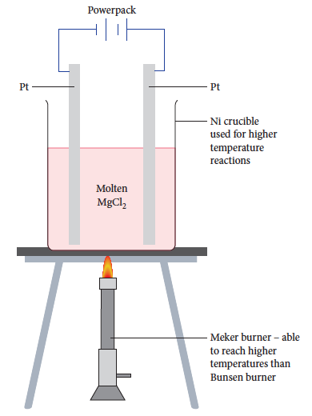
Molten salts
A molten ionic salt is a liquid form of the solid and contains free-moving anions and cations.
The liquid conducts electricity as the charged ions are free-moving.

Slide 40

Molten salts
For molten magnesium chloride, it contains magnesium ions, Mg²⁺, and chloride ions, Cl⁻.
At the anode, the chloride ions oxidise to form chlorine gas.
At the cathode, the magnesium ions reduce to form magnesium metal.

Slide 41

Molten salts
Using the standard electrode potentials for the two half-equations:
And writing a final equation:
The negative E° value indicates that the reaction is not spontaneous and electrical energy needs to be input for this reaction to occur.

Slide 42
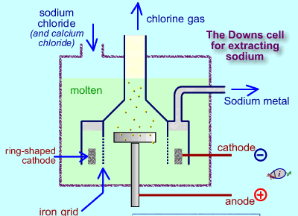
Downs cell re NaCl

Slide 43
Chapter 5: Electrochemical cells
Electrolytic cells – aqueous solutions

Slide 44
Basic factors
An aqueous ionic salt contains free-moving anions and cations as well as water molecules. All of these species compete to oxidise and reduce when electricity is applied.
Three factors decide which species react:
1 Nature of the electrolyte
2 Concentration of the electrolyte
3 Nature of the electrode

Slide 45
Nature of the electrolyte
Different ions have different E° values, so will oxidise or reduce more readily than others.
Water also has an E° value for both oxidation and reduction:
To determine which reactions occur, a comparison of standard electrode potentials is used.

Slide 46

Nature of the electrolyte – copper(II) bromide
In a solution of copper(II) bromide there are Cu²⁺ ions, Br– ions and water. At each electrode there are two possibilities.
At the anode, either bromide ions or water will oxidise:
2Br⁻ (aq) → Br₂ (l) + 2e⁻ Eº = -1.09V
2H₂O(l) → O₂ (g) + 4H⁺ (aq) +4e⁻ Eº = -1.23V
At the cathode, either copper ions or water will reduce:

Slide 47

Nature of the electrolyte
The reaction that requires the least energy (voltage) is the one that is more likely to occur.
Anode: bromide ions need less voltage to oxidise.
Cathode: copper ions need less voltage to reduce.

Slide 48

Concentration of the electrolyte
If the E°values of the competing reactions are close, then the concentrations of the species may determine which reaction occurs.
For copper(II) chloride, the table of standard electrode potentials shows that water will oxidise at the anode, and copper will reduce at the cathode.
The anode potentials are given below:

Slide 49
Concentration of the electrolyte
Because these values are so close, the concentration of chloride ions present
can change the result.
In a concentrated solution of chloride ions,
it is more likely to see a chloride ion oxidation
than if the solution is dilute.

Slide 50
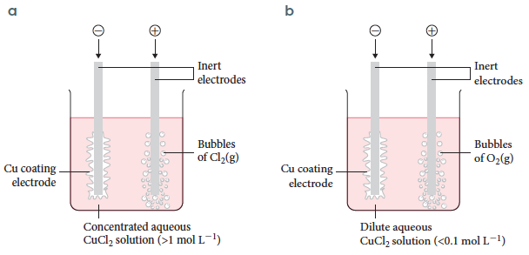
Concentration of the electrolyte
In a concentrated solution, chlorine gas will form as the chloride ions oxidise. In a dilute solution, oxygen gas will form as the water oxidises.

Slide 51
Nature of the electrode
Graphite is often used as an electrode because it is a cheap, inert conductor of electricity. Platinum is also used, but is more expensive and is mostly used in industry.
If reactive electrodes, for example metals, are used, they can impact on oxidation and reduction reactions that occur.

Slide 52
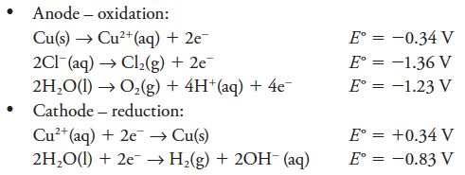
Nature of the electrode
A copper(II) chloride solution with graphite electrodes has already been discussed.
If copper electrodes are used instead of graphite, an extra equation must be considered:

Slide 53

Nature of the electrode
At the anode, the first reaction will occur as it has the lowest E° value.
Anode: the copper electrode is oxidised
Cathode: the copper ions are reduced
Overall cell voltage is 0.00 V so any voltage will cause the anode to decrease in mass while the cathode will increase in mass. Industrially, this is used to purify copper.

Slide 54
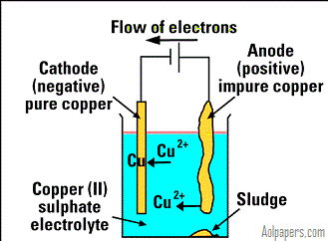
Electro purification of Copper >99.95% purity at cathode

